Slide 1
Fitness buddy
IBM HACKATHON PROJECT
Presented By: K H Arjun

Slide 2
OUTLINE
Problem Statement
Technology used
Wow factor
End users
Result
Conclusion
Git-hub Link
Future scope
IBM Certifications

Slide 3
Problem Statement
The challenge - In today’s fast-paced world, many individuals struggle to maintain a healthy lifestyle due to lack of personalized guidance, time constraints, and inconsistent motivation. Traditional fitness solutions often require expensive subscriptions, in-person consultations, or rigid schedules that don't adapt to personal preferences or daily routines. There is a growing need for an accessible, friendly, and intelligent virtual assistant that can provide ondemand fitness advice, healthy lifestyle suggestions, and basic nutrition guidance—all tailored to individual needs and available at any time. Fitness Buddy aims to solve this problem by offering a conversational, AI-powered health and fitness coach that can: Recommend home workouts and routines based on user input. • Provide motivational tips and daily fitness inspiration. • Suggest simple, nutritious meal ideas. • Encourage habit-building and consistency. Technology: Use of IBM cloud lite services /IBM Granity is mandatory

Slide 4
Technology used
IBM cloud lite services
Natural Language Processing (NLP)
Retrieval Augmented Generation (RAG)
IBM Granite model

Slide 5
IBM cloud services used
IBM Cloud Watsonx AI Studio
IBM Cloud Watsonx AI runtime
IBM Cloud Agent Lab
IBM Granite foundation model

Slide 6
Wow factors
This agent transforms the fitness journey by offering on-demand, personalized guidance that adapts to individual goals and routines. It removes the need for extensive planning, expensive trainers, or time-consuming research by delivering curated workouts, meal suggestions, and motivation in real-time. Ideal for beginners and busy individuals, it makes healthy living more accessible, consistent, and engaging.
Unique Features:
Semantic understanding of user fitness goals and preferences
Personalized workout plans based on time, level, and type
Quick, healthy meal suggestions tailored to dietary needs
Daily motivation with quotes, challenges, and habit tracking
Adaptive recommendations based on user behavior and progress
Consistency tracker to help build long-term healthy habits

Slide 7
End users
beginners
Busy Individuals
students
professionals

Slide 8
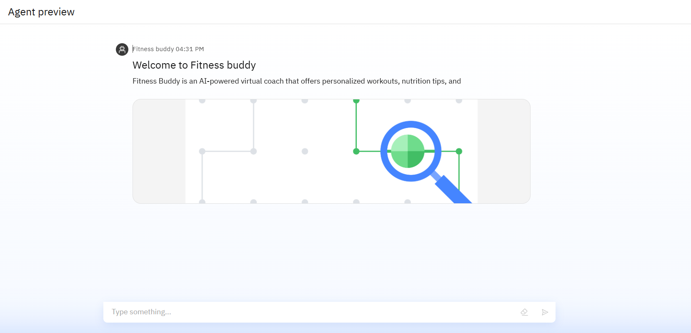
Results

Slide 9
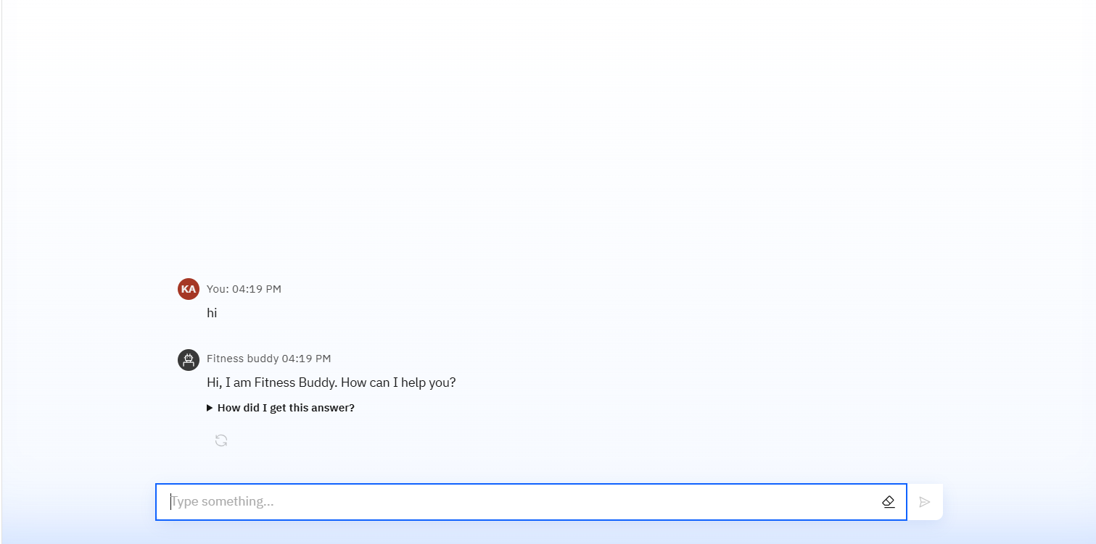
Results

Slide 10
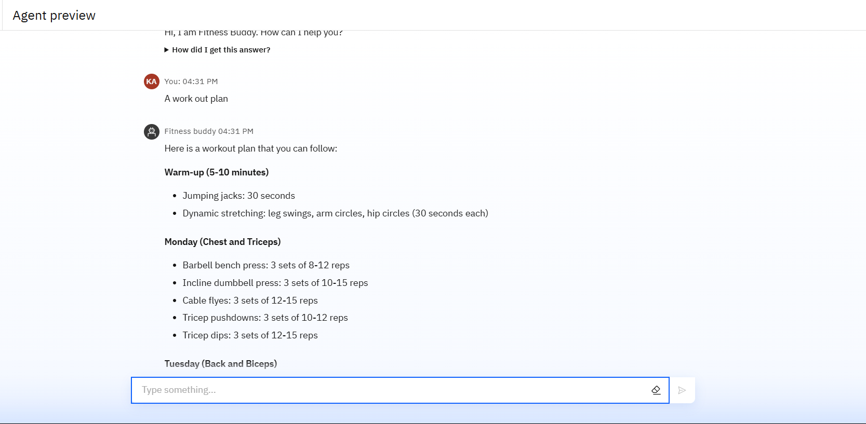
Results

Slide 11
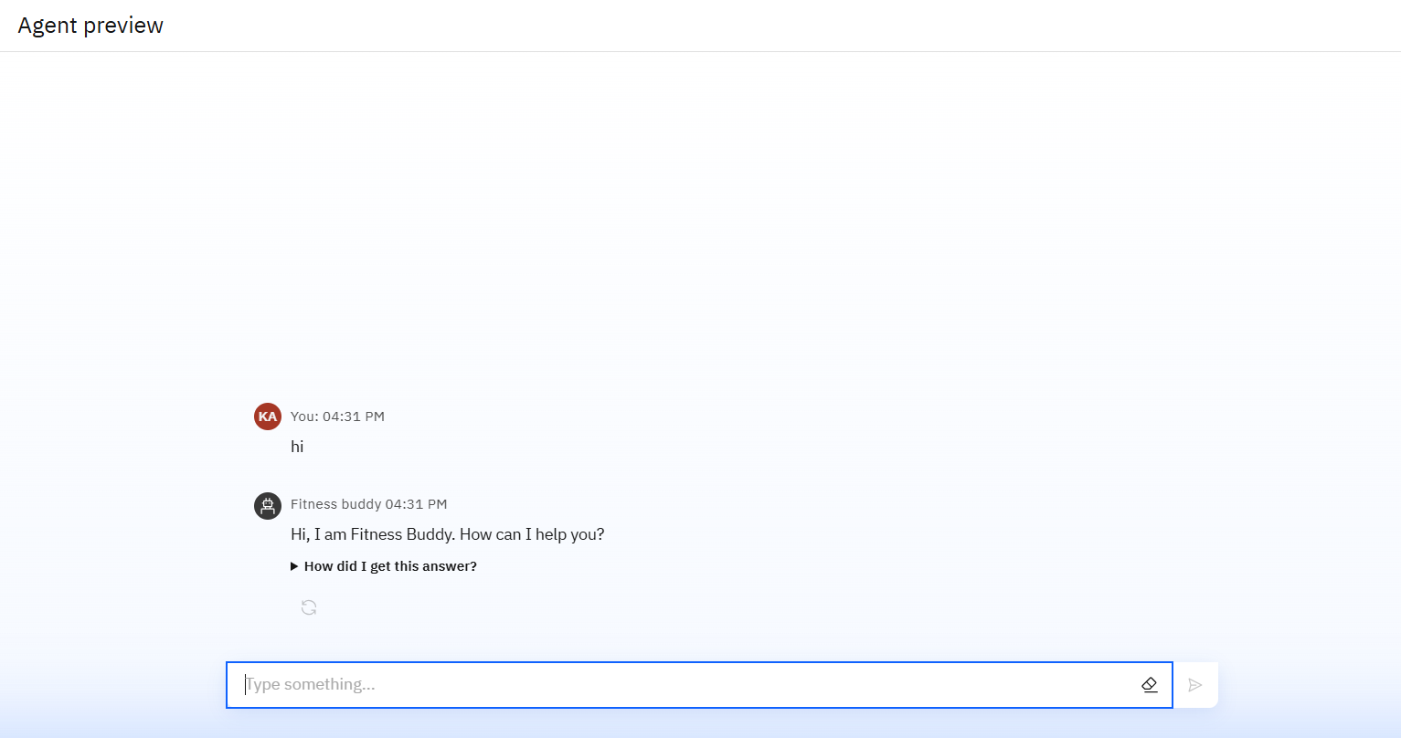
Results
Deployed AI Agent

Slide 12
Conclusion
The agent can recommend personalized workouts, suggest nutritious meals, and deliver motivational content tailored to user goals. It saves time by automating fitness planning, dietary suggestions, and habit tracking. Fitness agents enhance consistency, engagement, and overall wellness by making healthy living accessible, intelligent, and user-friendlyIt saves time by automating repetitive tasks like citation management and data extraction.

Slide 13
GitHub Link
https://github.com/arjun1232004/Fitnessbuddy.git

Slide 14
Future scope
Integration with werables
Voice-Activated Assistant
Real-Time Collaboration Features
Ai driven progress tracking
Multi language support
Community features

Slide 15
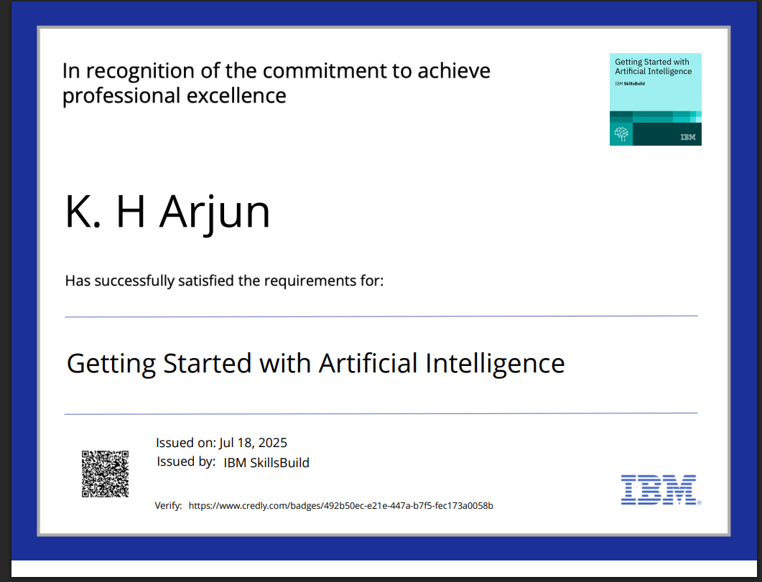
IBM Certifications

Slide 16
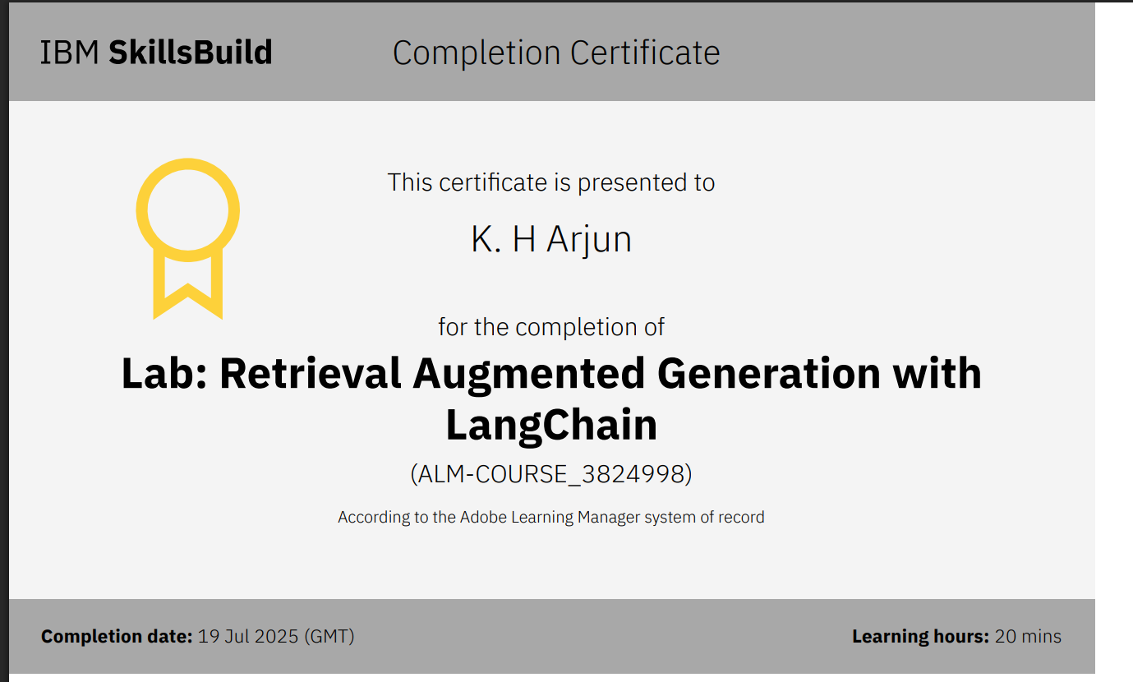

Slide 17
THANK YOU

